Slide 1
EDA Steps

Slide 2
Steps of EDA
Import pandas, NumPy, matplotlib, seaborn libraries
Import the excel file
Explore the columns
Explore the size (rows and columns)
Explore the type of data i.e. datatype (integer or object)
Use describe function to explore the mean, SD , etc.
Find any null values
Plot count plot for all columns

Slide 3
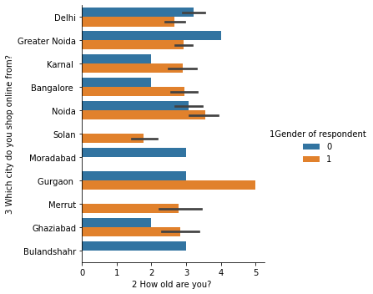
Age vs City vs Gender

Slide 4
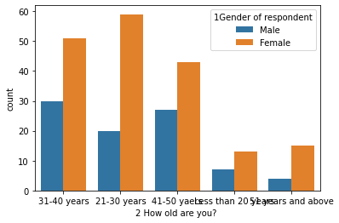
Age vs Gender

Slide 5
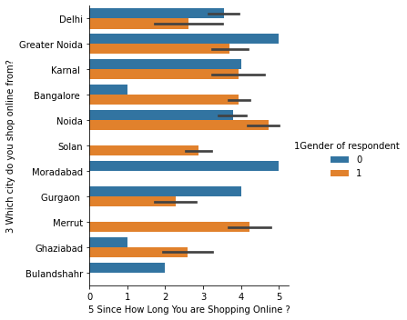
Shopping online vs City vs Gender

Slide 6
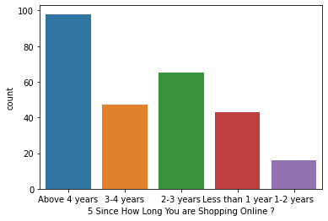
Since how long shopping online:

Slide 7
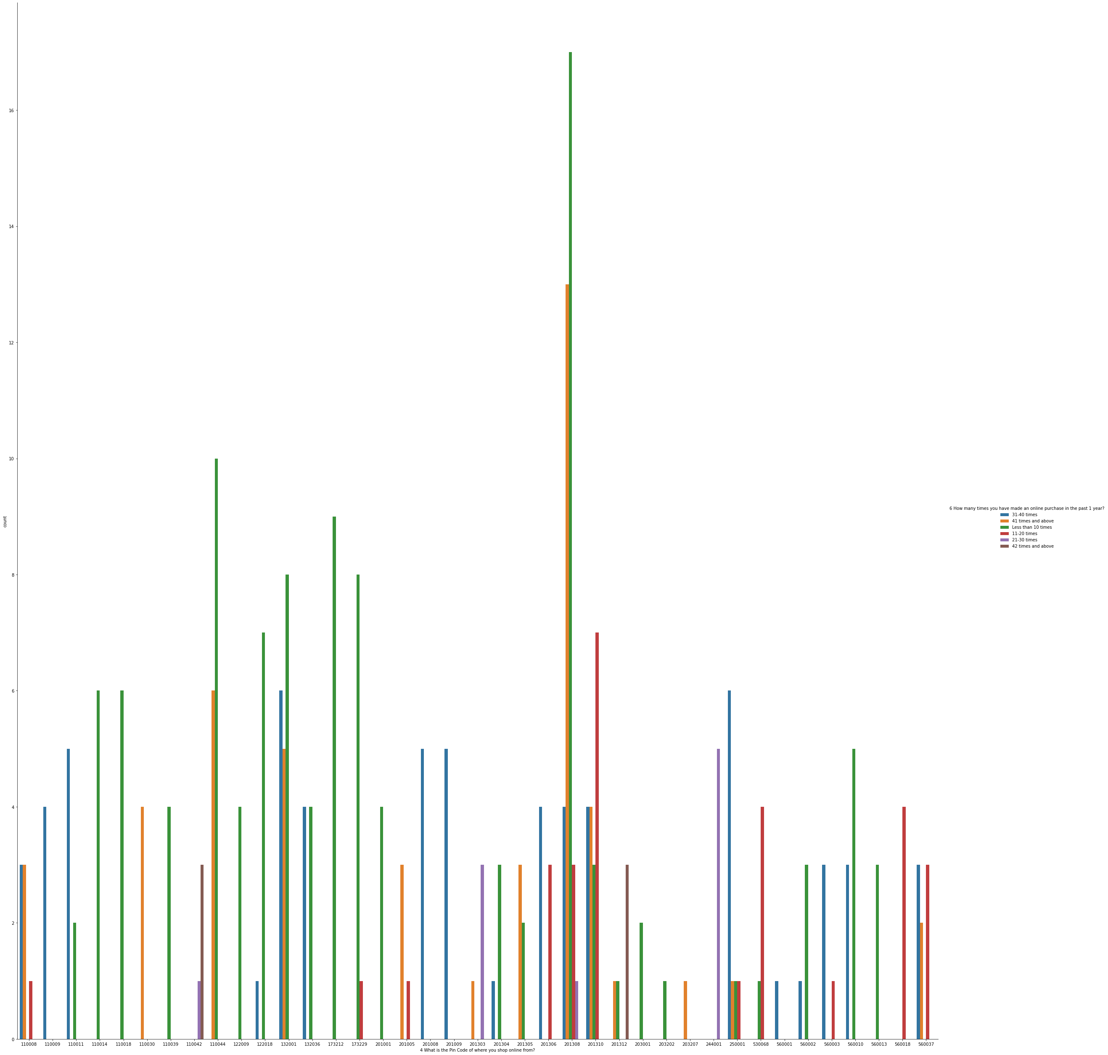
Pin Code of where you shop online from

Slide 8
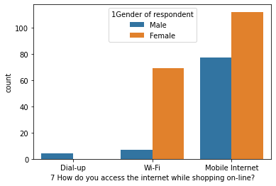
How do you access the internet while shopping on-line

Slide 9
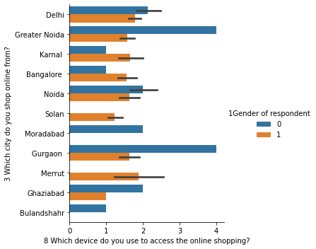
Which device do you use to access the online shopping

Slide 10
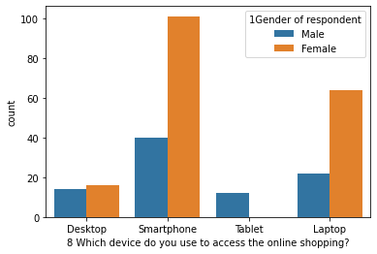
8 Which device do you use to access the online shopping

Slide 11
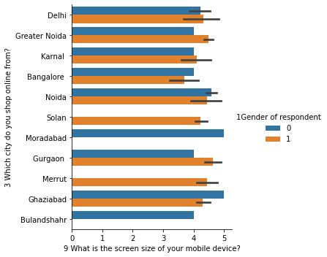
9 What is the screen size of your mobile device

Slide 12
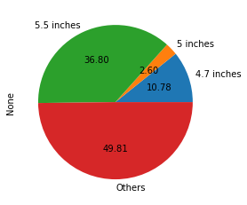
9 What is the screen size of your mobile device?

Slide 13
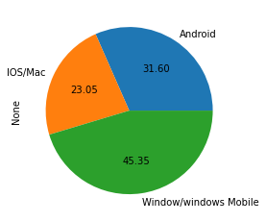
Operating system (OS) of your device

Slide 14
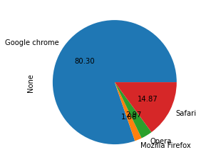
What browser do you run on your device to access the website?

Slide 15
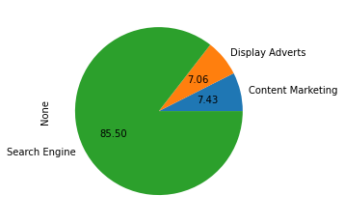
Which channel did you follow to arrive at your favorite online store for the first time?

Slide 16
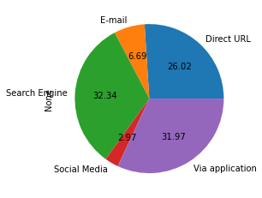
After first visit, how do you reach the online retail store?

Slide 17
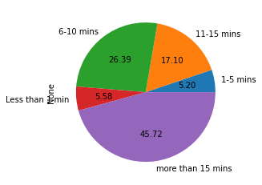
How much time do you explore the e- retail store before making a purchase decision?

Slide 18
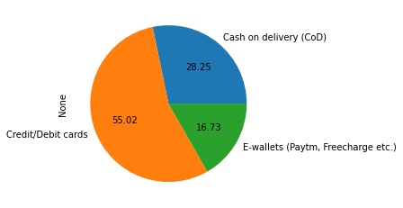
What is your preferred payment Option?

Slide 19
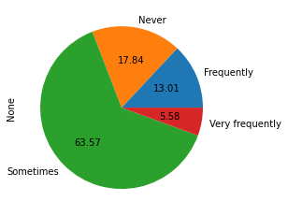
How frequently do you abandon (selecting an items and leaving without making payment) your shopping cart?

Slide 20
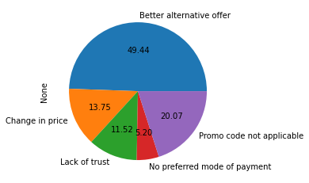
Why did you abandon the “Bag”, “Shopping Cart”?

Slide 21
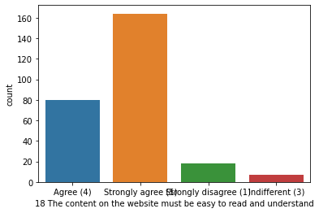
The content on the website must be easy to read and understand

Slide 22
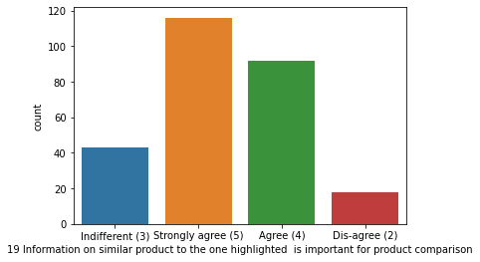
Information on similar product to the one highlighted is important for product comparison

Slide 23
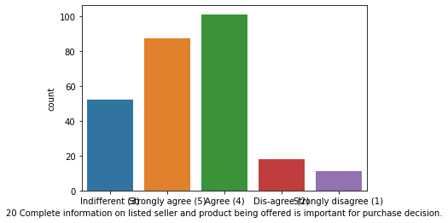
Complete information on listed seller and product being offered is important for purchase decision.

Slide 24
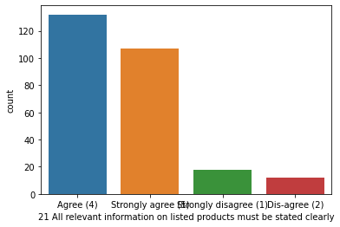
All relevant information on listed products must be stated clearly

Slide 25
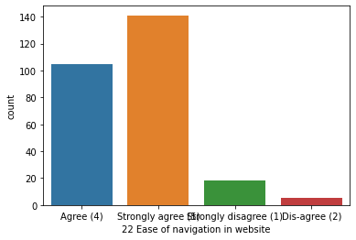
Ease of navigation in website

Slide 26
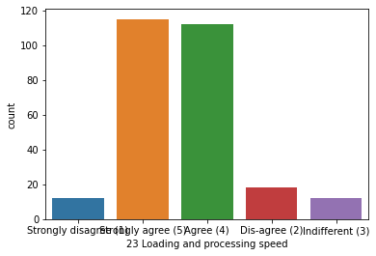
Loading and processing speed

Slide 27
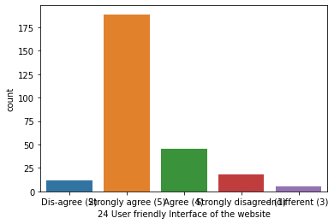
User friendly Interface of the website

Slide 28
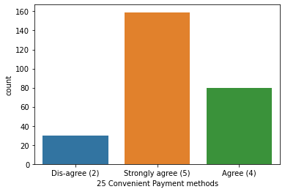
Convenient Payment methods

Slide 29
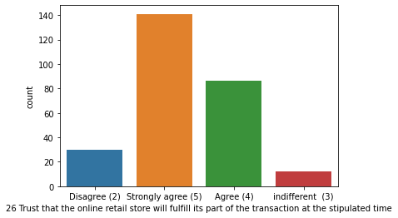
Trust that the online retail store will fulfill its part of the transaction at the stipulated tim

Slide 30
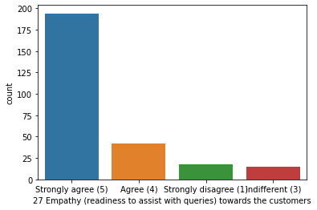
Empathy (readiness to assist with queries) towards the customers

Slide 31
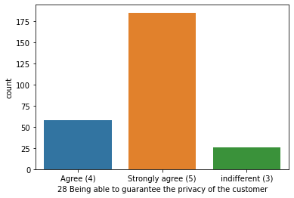
Being able to guarantee the privacy of the customer

Slide 32
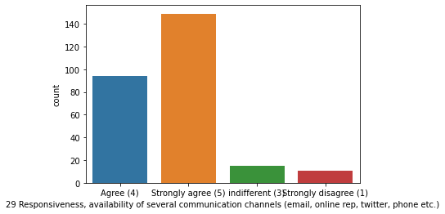
Responsiveness, availability of several communication channels (email, online rep, twitter, phone etc

Slide 33
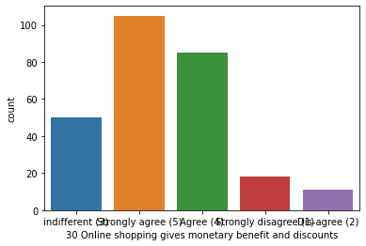
Online shopping gives monetary benefit and discounts

Slide 34
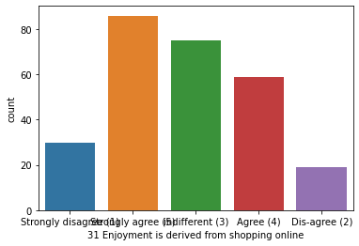
Enjoyment is derived from shopping online

Slide 35
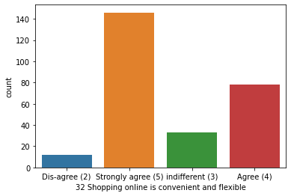
Shopping online is convenient and flexible

Slide 36
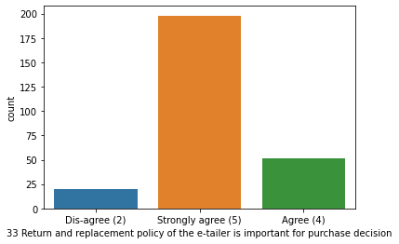
Return and replacement policy of the e-tailer is important for purchase decision

Slide 37
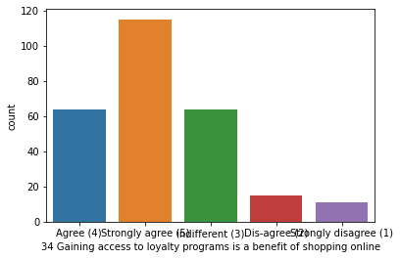
Gaining access to loyalty programs is a benefit of shopping online

Slide 38
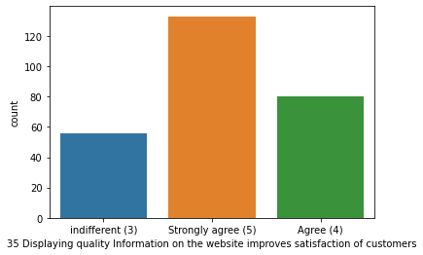
Displaying quality Information on the website improves satisfaction of customers

Slide 39
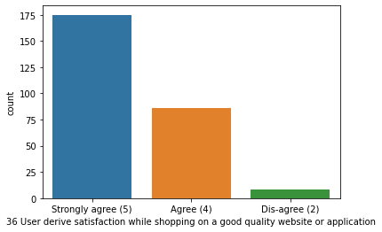
User derive satisfaction while shopping on a good quality website or application

Slide 40
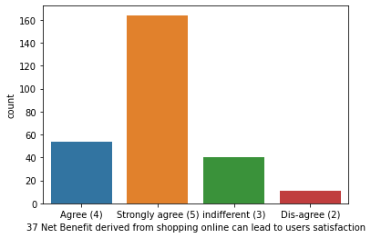
Net Benefit derived from shopping online can lead to users satisfaction

Slide 41
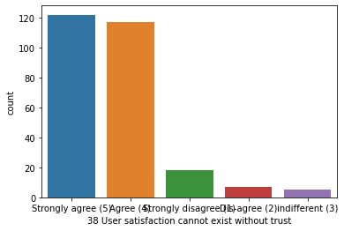
User satisfaction cannot exist without trust

Slide 42
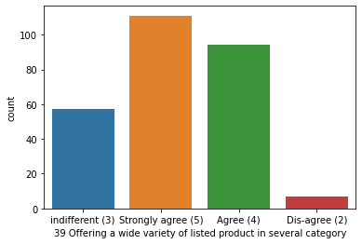
Offering a wide variety of listed product in several category

Slide 43
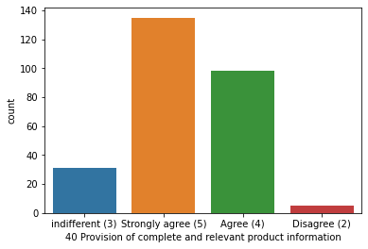
Provision of complete and relevant product information

Slide 44
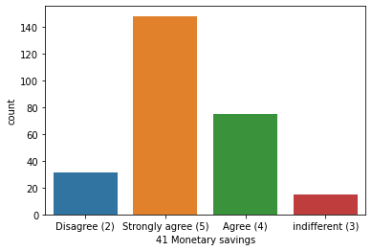
Monetary savings

Slide 45
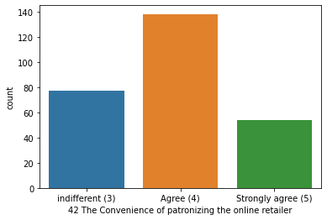
The Convenience of patronizing the online retailer

Slide 46
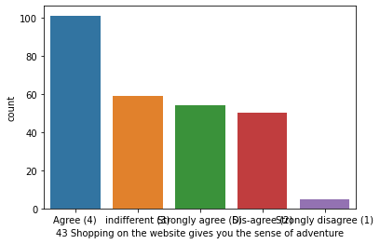
Shopping on the website gives you the sense of adventure

Slide 47
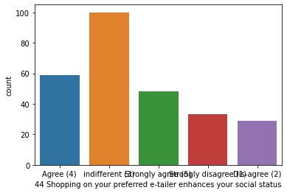
Shopping on your preferred e-tailer enhances your social status

Slide 48
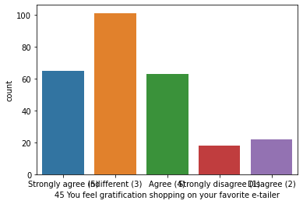
You feel gratification shopping on your favorite e-tailer

Slide 49
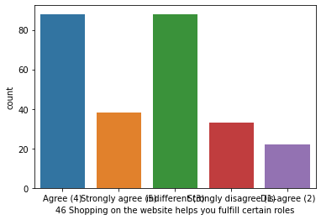
Shopping on the website helps you fulfill certain roles

Slide 50
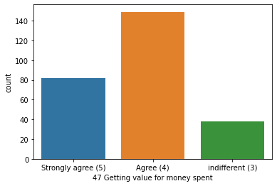
Getting value for money spent

